Slide 1
The simple User Guide for Interwise

Slide 2
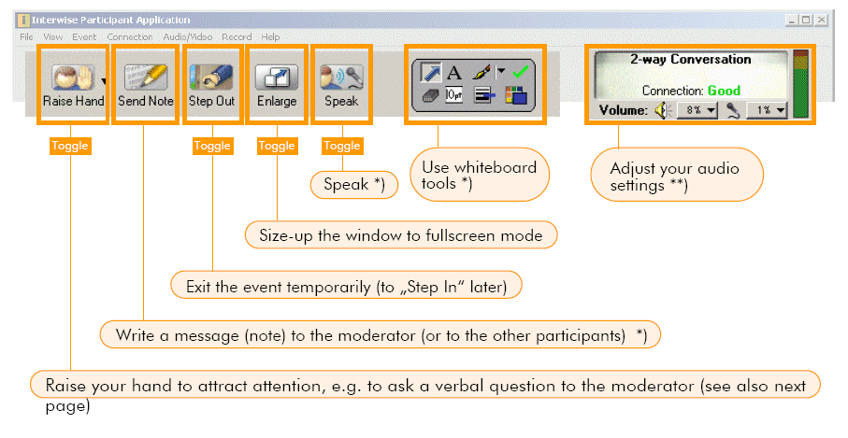


Introduction

Slide 3

Introduction

Slide 4
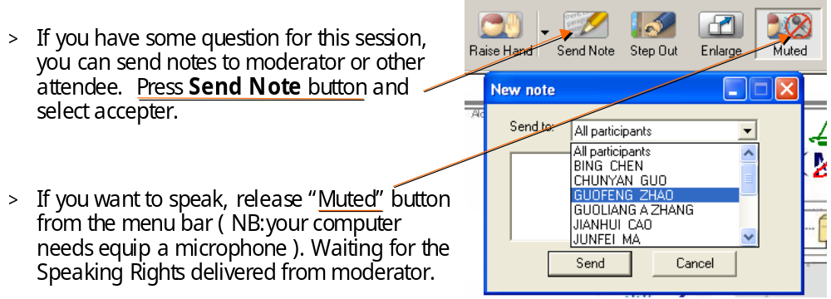
Participant

Slide 5
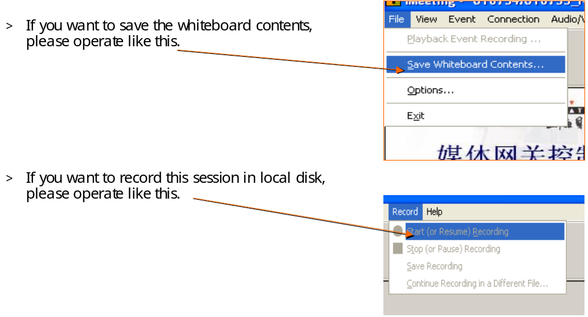
Participant

Slide 6
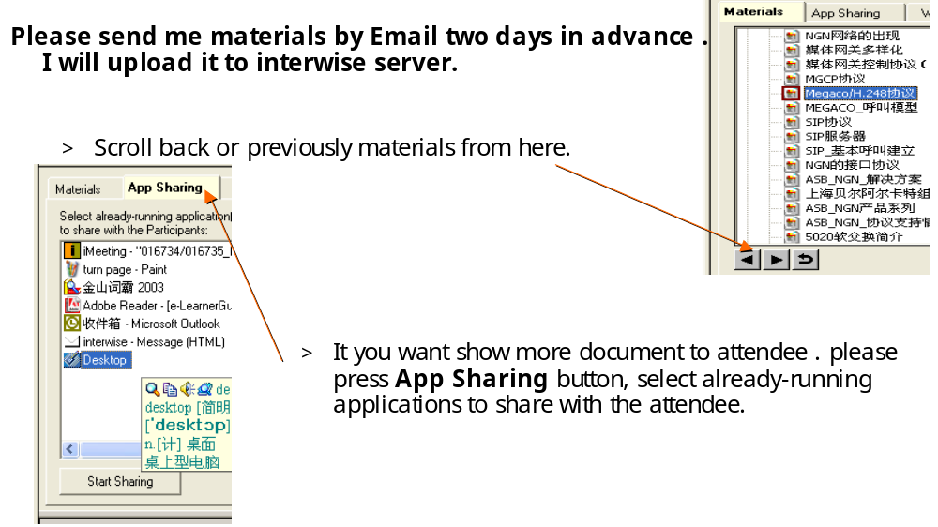
Moderator

Slide 7
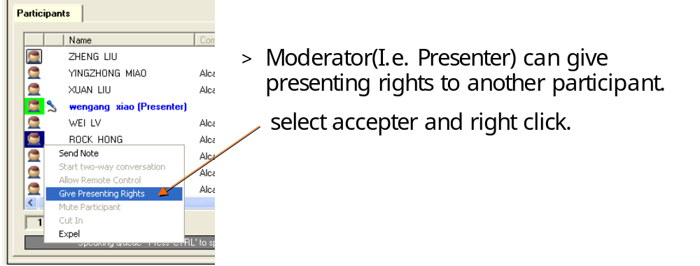
Moderator

Slide 8
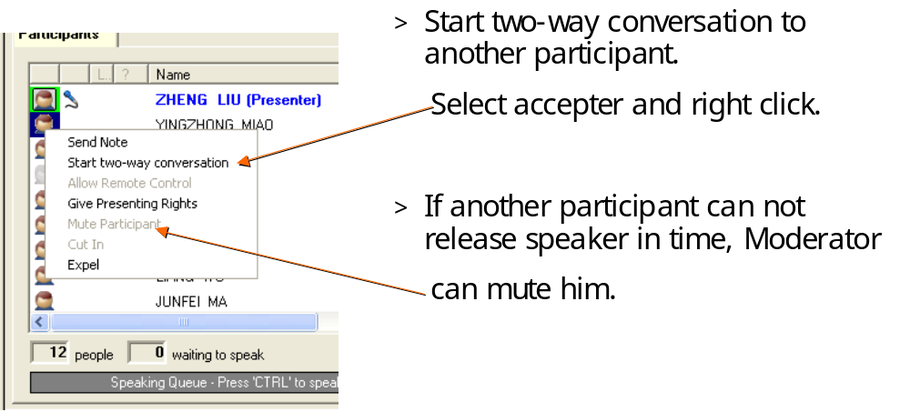
Moderator

Slide 9
Introduction
For more info on simple participant, occasional user or FAQ
Please access:
http://aww.alcatel.com/group/ist/solutions/video/index_ecom.htm

Slide 10

SAU Liu Zheng
Zheng.liu@alcatel-sbell.com.cn
Notes:
This slide may be used as the final slide of a presentation and can be displayed during a Question-and-Answer portion of a talk

